Slide 1

UNIVERSITY OF RWANDA
COLLEGE OF SCIENCE AND TECHNOLOGY
Y3 CSE
Group 4: TransConnect
  Members: MUSAZA PATRICK (223019061)
  MANZI NSENGA IVAN (223004392)
Module: Computing Intelligence & Applications
Date: 27th November 2025

Slide 2



Cont…
Selected Models for TransConnect
3. Gradient Boosting Regression – Ensemble model of many decision trees
4. Decision Tree – supervised non‑linear model
CASE STUDY
ROUTE
Kabuga - Nyabugogo

Slide 3





Advantages:
  High prediction accuracy
  Handles complex relationships
  Great for time‑based forecasting
Gradient Boosting – What Was Completed
Disadvantages:
  Slower training
  Sensitive to hyperparameters
  Can overfit if not tuned
Learns sequentially: each tree corrects previous errors
Very powerful for structured data
Key Features:
High‑accuracy ETA prediction
Modeling traffic effects on travel time
Works Well on Linearly Related Data (travel time, distance, time of day, road features)

Slide 4
Code Snippet
Import Libraries
Set Model
import pandas as pd
import numpy as np
import matplotlib.pyplot as plt
from sklearn.model_selection import train_test_split
from sklearn.ensemble import GradientBoostingRegressor
from sklearn.metrics import mean_absolute_error, mean_squared_error, r2_score
model = GradientBoostingRegressor(
n_estimators=300,
learning_rate=0.05,
max_depth=4,
random_state=42
)
Train Dataset
Performance Metric
X = df[["distance", "is_traffic"]]
y = df["travel_time"]
X_train, X_test, y_train, y_test = train_test_split(X, y, test_size=0.25, random_state=42)
model.fit(X_train, y_train)
y_pred = model.predict(X_test)
residuals = y_test - y_pred
mae = mean_absolute_error(y_test, y_pred)
mse = mean_squared_error(y_test, y_pred)
rmse = np.sqrt(mse)
r2 = r2_score(y_test, y_pred)

Slide 5
VISUALIZATION

Slide 6
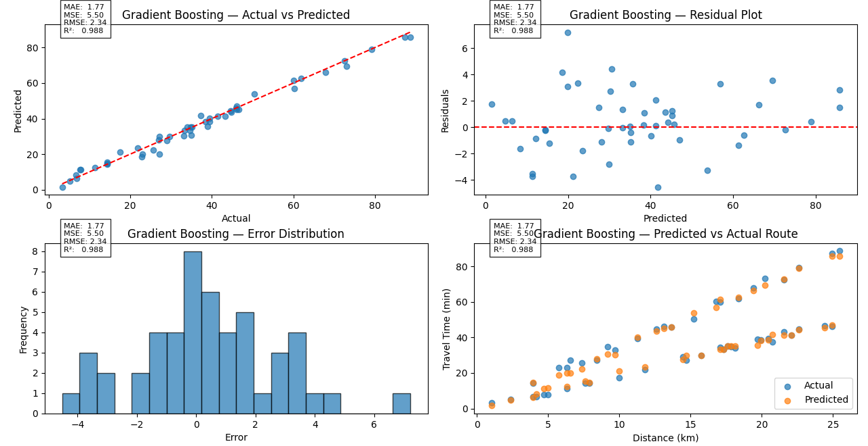

Slide 7
Decision Tree – What Was Completed
Advantages:
  Simple and interpretable
  Handles non-linear data
  Works well with small datasets
Supervised non-linear model
Splits data into rules based on thresholds
Easy to interpret and visualize
Key Features:
Predicting travel time by condition (traffic vs normal)
Disadvantages:
  Can overfit without pruning
  Unstable with small changes in data
Detecting unusual stops or delays
Fast to train, good for quick predictions

Slide 8
CODE SNIPPET
Library
Model Fitting
import pandas as pd
import numpy as np
import matplotlib.pyplot as plt
from sklearn.model_selection import train_test_split
from sklearn.tree import DecisionTreeRegressor
from sklearn.metrics import mean_absolute_error, mean_squared_error, r2_score
model = DecisionTreeRegressor(max_depth=6, random_state=42)
model.fit(X_train, y_train)
y_pred = model.predict(X_test)
residuals = y_test - y_pred
Train Model
Performance Metric
X = df[["distance", "is_traffic"]]
y = df["travel_time"]
X_train, X_test, y_train, y_test = train_test_split(X, y, test_size=0.25, random_state=42)
mae = mean_absolute_error(y_test, y_pred)
mse = mean_squared_error(y_test, y_pred)
rmse = np.sqrt(mse)
r2 = r2_score(y_test, y_pred)

Slide 9
VISUALIZATION

Slide 10
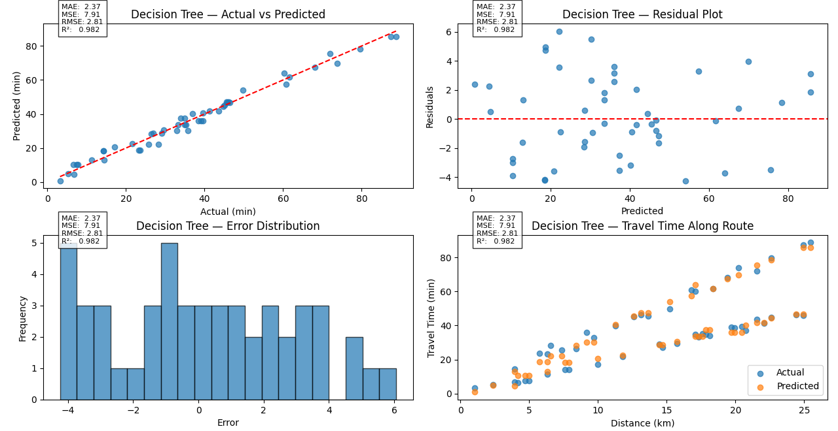

Slide 11
GRADIENT BOOSTING REGRESSION
VS
DECISION TREE

Slide 12
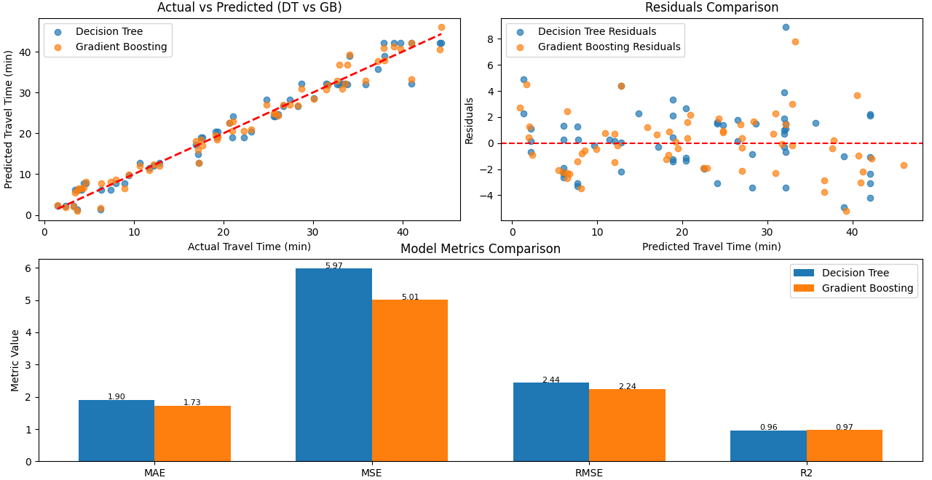

Slide 13
SUMMARY
Decision Tree & Gradient Boosting
Good for quick rule‑based predictions
Easy to interpret
Best accuracy
Ideal for real‑time ETA predictions

Slide 14
GRADIENT BOOSTING REGRESSION
CODE
DECISION TREE
– FULL SOURCE CODE
Gradient Model
Decision Model

Slide 15
Challenges
Limited historical data
GPS noise and inconsistent‑format coordinates
Few features available for prediction
Hard to validate ETA accuracy in real time

Slide 16




Mitigation Measures
Collect more real bus timing logs (according to passengers, like us)
Apply smoothing & cleaning to GPS streams
Add engineered features (traffic, rush hour, holidays)
Test across multiple routes for reliability

Slide 17
BEST MODEL
– AMONG ALL
GRADIENT BOOSTING

Slide 18
END

